Slide 1
Game Physics Basics
Rigid Bodies
By Himanshu Kapoor (20BCG10010)

Slide 2
What is Rigid Body?
Rigid Bodies in game engine

Slide 3
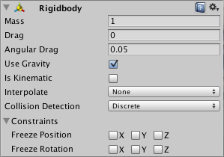
Rigid Bodies
The idealization of a body that does not deform or alter shape is a hard body. It is defined in formal terms as a collection of particles having the property that the spacing between them remains constant during body motions.
In words of a game developer, Rigidbodies are components that allow a game object to be effected by physics. They allow the object to fall under gravity, and have physics properties such as mass, drag and velocity.
A rigidbody component is required for any physics based interaction, and the game object must also have a collider attached in order to interact with other physics objects.

Slide 4
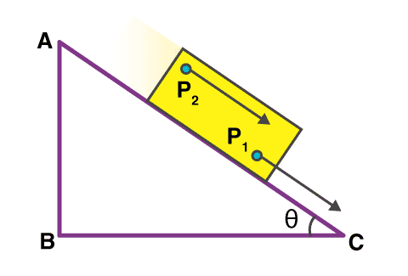
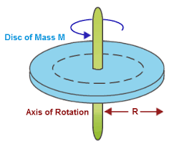
Types of Rigid Body motions
Translational motion
Rotational motion
The motion with the help of which a body moves from one point in space to another is known as the Translational motion. A typical example of Translatory motion is the motion of a bullet fired from a gun.
Rotational motion is a common type of circular motion. When an object rotates or spins about its axis, it is said to be exhibiting rotatory motion. Some examples of rotary or rotatory motion include the motion of a spinning top, rotation of the earth and other planets, movement of hands of a clock, etc.

Slide 5
Properties of rigidBodies in Unity

Slide 6
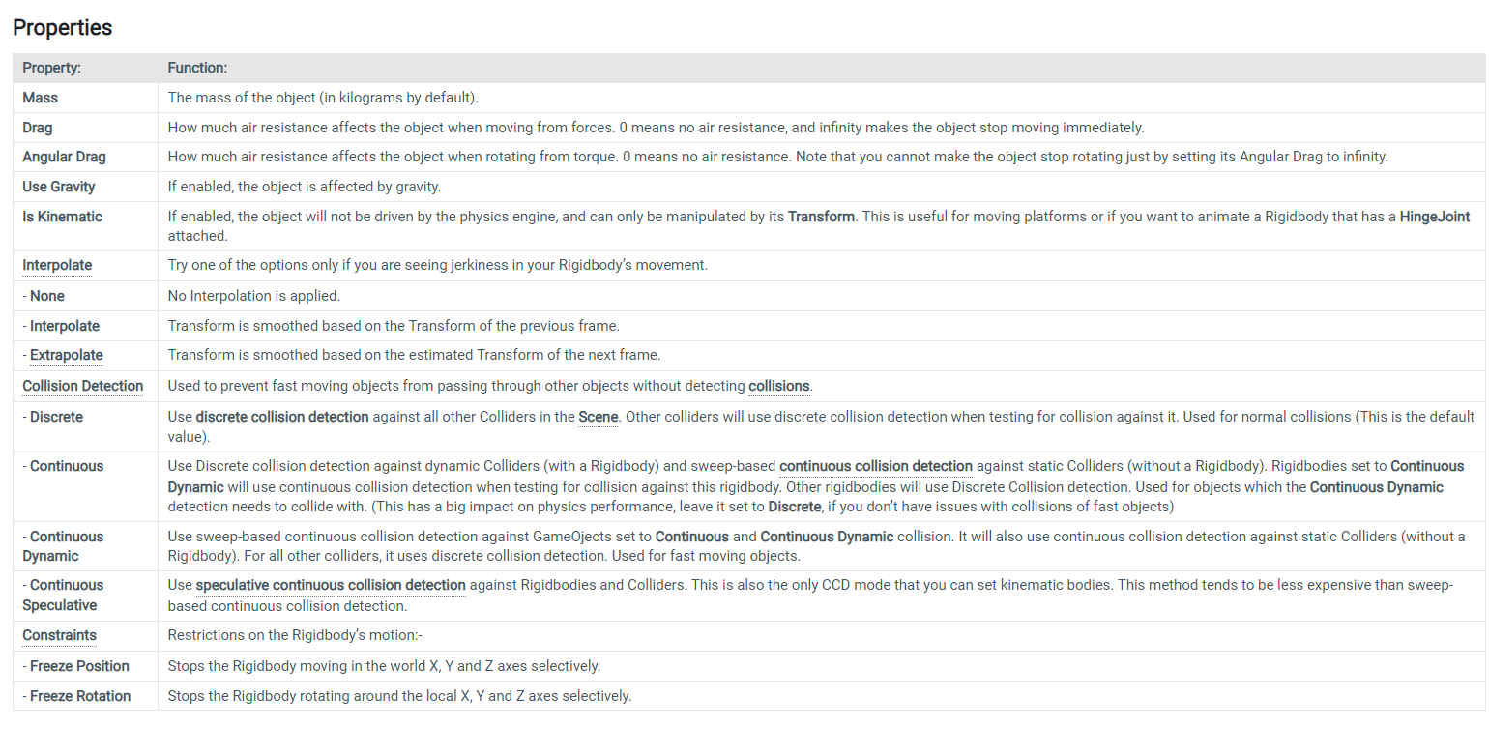
Properties of rigidBody in Unity

Slide 7
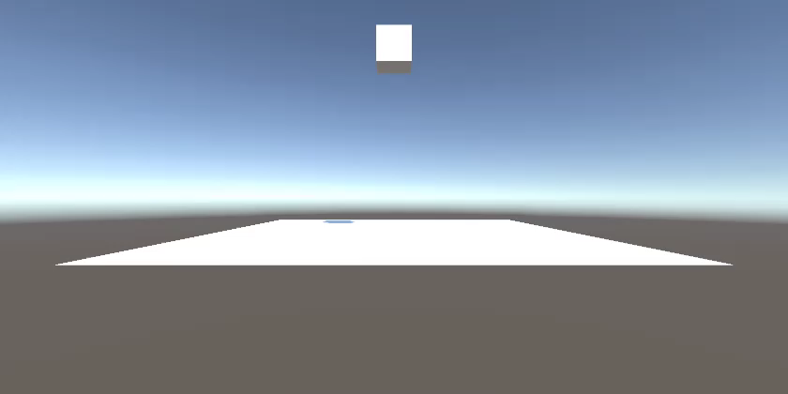
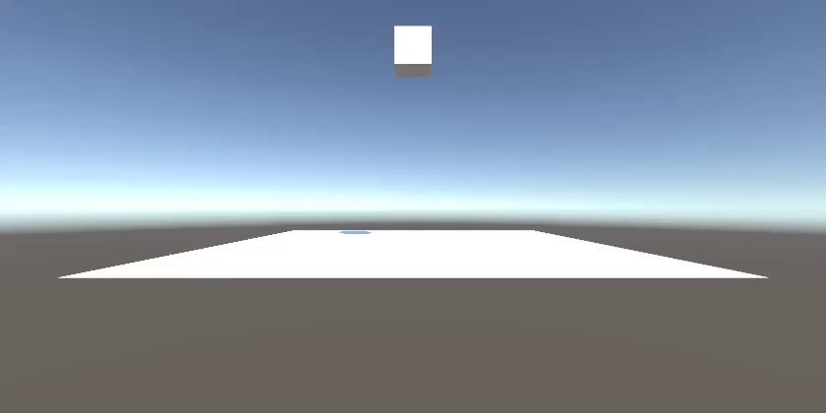
Rigid Body v/s Non Rigid Body

Slide 8
Some interesting/important points
Rigidbodies allow your GameObjects to act under control of the physics engine. This opens the gateway to behaviors such as realistic collisions and varied types of joints.
The biggest difference between manipulating the Transform versus the Rigidbody is the use of forces. Rigidbodies can receive forces and torque, but Transforms cannot.
Changing the Transform while using physics could cause problems with collisions and other calculations.
Rigidbodies must be explicitly added to your GameObject before they will be affected by the physics engine.
You can add a Rigidbody to your selected object from Components->Physics->Rigidbody in the menu. Now your object is physics-ready; it will fall under gravity and can receive forces via scripting, but you may need to add a Collider or a Joint to get it to behave exactly how you want.

Slide 9
Acknowledgement
I would like to express my special thanks of gratitude to my teacher Dr.R.Shriram, who gave me the golden opportunity to do this wonderful project of Game Physics basics on “Rigid Body” and guided me through approval process. It widened my knowledge and introduced me to some untouched expects of the same. I would also like to thank my friends and the online sources which helped me finalize the project within the limited time frame.
Himanshu Kapoor
20BCG10010

Slide 10
References
https://docs.unity3d.com/Manual/class-Rigidbody.html
https://en.wikipedia.org/wiki/Rigid_body
https://www.youtube.com/

Slide 11
Thank you

